Slide 1
Find and Fix Errors In Java Source Code
Bloom’s Taxonomy: Understanding

Slide 2
Given a java program that contains errors: find, document, and fix the errors
The instructor will (re)view the syntax for the new language feature that we’re learning
The instructor will provide you with a Java program to examine
In a small group you will have 10-15 minutes to read through the program. Make sure to find, document, and fix each of the errors in the program.
There will be syntax errors and semantic (logical) errors
Always record all the errors in a Word/PDF file: “Find_And_Fix_Errors_Table.docx”

Slide 3
Finding and fixing Syntax errors
You can find these by trying to compile (or run) the program and seeing what error messages you get
WARNING: The Java error message tells you where Java got confused It does NOT (necessarily) tell you what the error is.
(Sometimes the error message tells you exactly what caused the error, but many times it won’t)

Slide 4
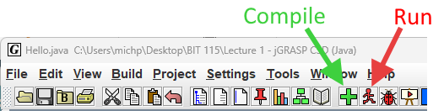
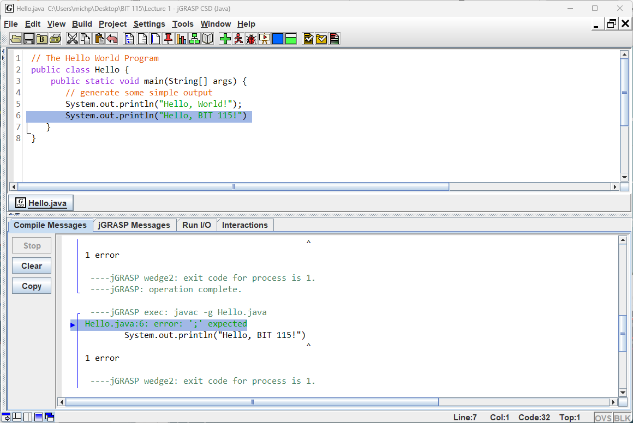
Finding and fixing Syntax errors – jGRASP advice
In jGRASP: Click the ‘Run’ button at the top (or the ‘Compile’ button)
In the ‘Compile Messages’ panel on the bottom, look for error messages.
HINT: You can click on the file name and it’ll show you to the line of the file where it got confused

Slide 5
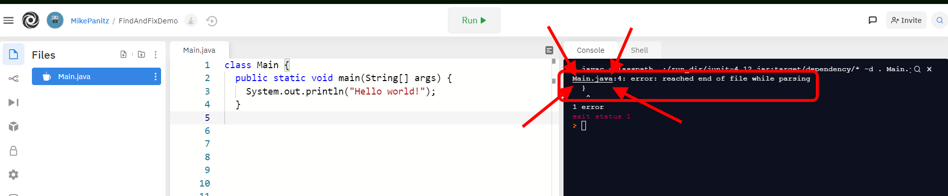
Finding and fixing Syntax errors – Repl.it advice
In Repl.it: Click the ‘Run’ button at the top
In the ‘Console’ panel on the right, look for error messages.
HINT: You can click on the file name and it’ll show you to the line of the file where it got confused

Slide 6
Finding and fixing Syntax errors – General advice
Try comparing your problem to a program that works (compiles, runs, etc)
Algorithm:
“An algorithm is a sequence of steps that specifies how to solve a problem.” – Chapter 1
Click ‘Run’
fix the first error
If you’re stuck on this error it’s ok to look at the first 2-3 errors to see if you can make progress with any other errors instead of the very first one
then write down:
the line number that CAUSES the problem
a description of the cause of the error in your own words
a new line of Java that fixes the problem
then start this process over again

Slide 7
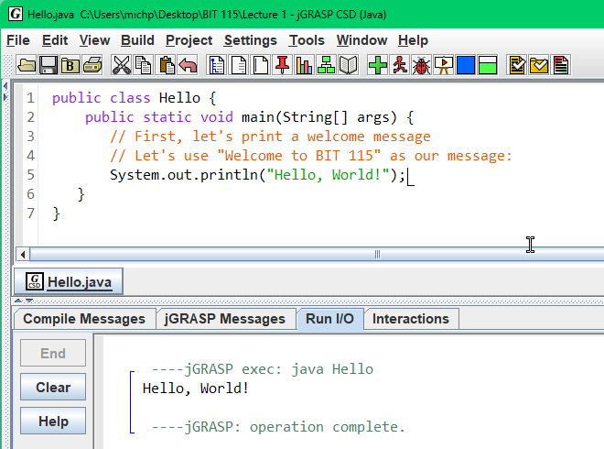
Finding and fixing Logical errors (Bugs)
Logical errors (bugs) mean that the program compiled and ran, but didn’t do what we wanted it to.
You’ll know what the program should do from two main sources:
Instructions / directions for the assignment / in class exercise / etc
Comments in the code itself
Example:

Slide 8
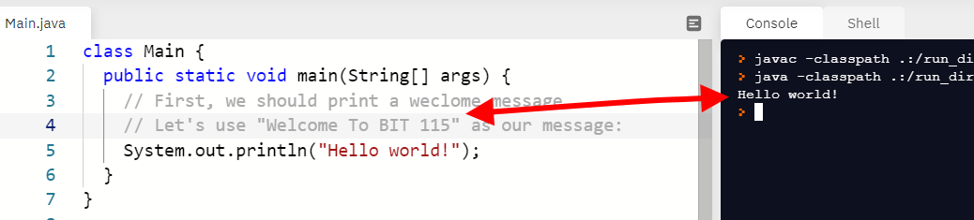
Finding and fixing Logical errors (Bugs)
Logical errors (bugs) mean that the program compiled and ran, but didn’t do what we wanted it to.
You’ll know what the program should do from two main sources:
Instructions / directions for the assignment / in class exercise / etc
Comments in the code itself
Example:

Slide 9
Finding and fixing Logical errors (Bugs) –advice
Algorithm:
Once you’ve fixed the syntax errors, run the program and see what it does.
Next, go back to the directions and read them closely while re-running the program. Make sure that the program follows the directions.
Any time that you find that the program does not follow the directions, you should write down the line number that CAUSES the problem, describe the cause of the error in your own words, AND write down a new line of Java that fixes the problem.
Next, go back to the program source code and read the comments closely , while re-running the program. Make sure that the program follows the comments.
Any time that you find that the program does not follow the directions, you should write down the line number, the cause of the error in your own words, and a fix for the problem.

Slide 10
Quick Example:
Line # | Java Code
1 | // Code to demonstrate 'find and fix'
2 | class Main {
3 | public static void main(String[] args) {
4 | // First, we should print a weclome message
5 | // Let's use "Welcome To IT-CS 115" as our message:
6 | System.out.println("Hello world!");
7 | }
8
Line # | Error Description | Fixed Java Code
8 | Missing } | }
6 | Comment on lines 3, 4 says that we should print out “Welcome to IT-CS 115” | System.out.println(“Welcome to IT-CS 115”);
The order doesn’t matter (you do NOT have to arrange by increasing line number)
Write down whatever line number you see when you fix the error
Even if you add lines, remove lines, etc

Slide 11
Variables & Expressions
Bloom’s Taxonomy: Understanding
Textbook notes
(For use in lecture? Maybe?)

Slide 12
Notes From The Text (Chapter 1)
Java is case sensitive
Main, main, and MaIn are all different
{ } group things together
Is you see { then look for the matching }
// is a comment
Everything after it on that line is ignored by Java. We use it to leave ourselves notes about what the program does, and how it does it
All statements end with ;
You need at least one space between words
Ok: public static void main
Error: publicstaticvoidmain
Newlines are optional, but helpful
Legal but bad: System.out.print("Goodbye, ");System.out.println ("cruel world");
Legal and good: System.out.print("Goodbye, "); System.out.println("cruel world");
Escape sequences in strings:
\n \t \” \\

Slide 13
Notes From The Text (Chapter 2)
Variables names
Camel case is a convention, not a rule
No using Java reserved words / keywords
Assignment
New value replaces the old / existing one
Must match types
Printing variables
println vs. print
Arithmetic operators
These do NOT change variables (unless there’s a = )
Variables are substituted/replaced, then expression is evaluated
Variables are replaced with the current value
Integer division
PEMDAS
Left to right associativity

Slide 14
Notes From The Text, Part 2
Floating point numbers
Can’t assign to ints
Rounding errors
Know they exist, but you don’t have to be able to predict them
Strings
+ is defined (it’s concatenation)
The other arithmetic operators aren’t defined on strings ( * , / , etc)
Errors
Syntax / Compile-time errors
Run-time: program crashes
Logic error – program runs, but doesn’t do what we want it to

